Slide 1
BARRIERS TO COMMUNICATION

Slide 2
What is a barrier?
Barrier is something that prevents movement.
It comes in the way of the desired outcome.
Identify the different barriers in a workplace.

Slide 3
Examples of some barriers
Manager is frustrated and says no one listens to him.
Employee fails to understand what is being discussed in a meeting.
An employee sends an email which the manager cannot understand.
The projector stops working during a presentation.

Slide 4
Identify the barrier in the following text
You ask your subordinate to write a bimonthly report, and until the next month, he has not done so. When you ask him about the delay, he replies that he was asked to produce the report bimonthly. He said would submit the report after two months.

Slide 5
How do you identify that there is a problem?
When there is a lack of desired feedback, then there might be a problem.
Analyze the feedback properly.
Find out the cause of the problem.
Identify solutions.

Slide 6
5 step solution to any barrier
Identify the problem
Find the cause/barrier
Work on alternative solutions
Opt for the best solution
Follow up

Slide 7
What is noise?
Any interference in the message sent and the message received leads to the production of ‘noise.’
Noise does not mean sound but a break or disturbance in the communication process.

Slide 8
CLASSIFICATION OF BARRIERS
INTRAPERSONAL
INTERPERSONAL
ORGANIZATIONAL

Slide 9
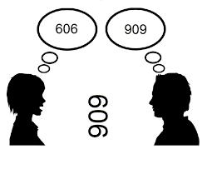
INTRAPERSONAL BARRIERS
Every person interprets the same information in different ways because the way we think varies.
The difference in the way of thinking leads to interpersonal barriers.

Slide 10
Causes of intrapersonal barriers
Wrong assumptions
Varied perceptions
Differing background
Wrong information
Blocked categories
Categorical thinking

Slide 11
Wrong assumption
What is SOS?
SOS is actually a morse code distress signal used especially by ships.
Example: When a doctor gives a patient a medicine marked as SOS (i.e. during an emergency) without explaining the meaning of SOS.
Here the doctor has made the wrong assumption that the patient knows the meaning of SOS.
To avoid wrong assumptions, put yourself in the shoes of the listener. Try to understand their background, educational qualifications, language of communication.

Slide 12
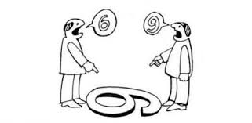
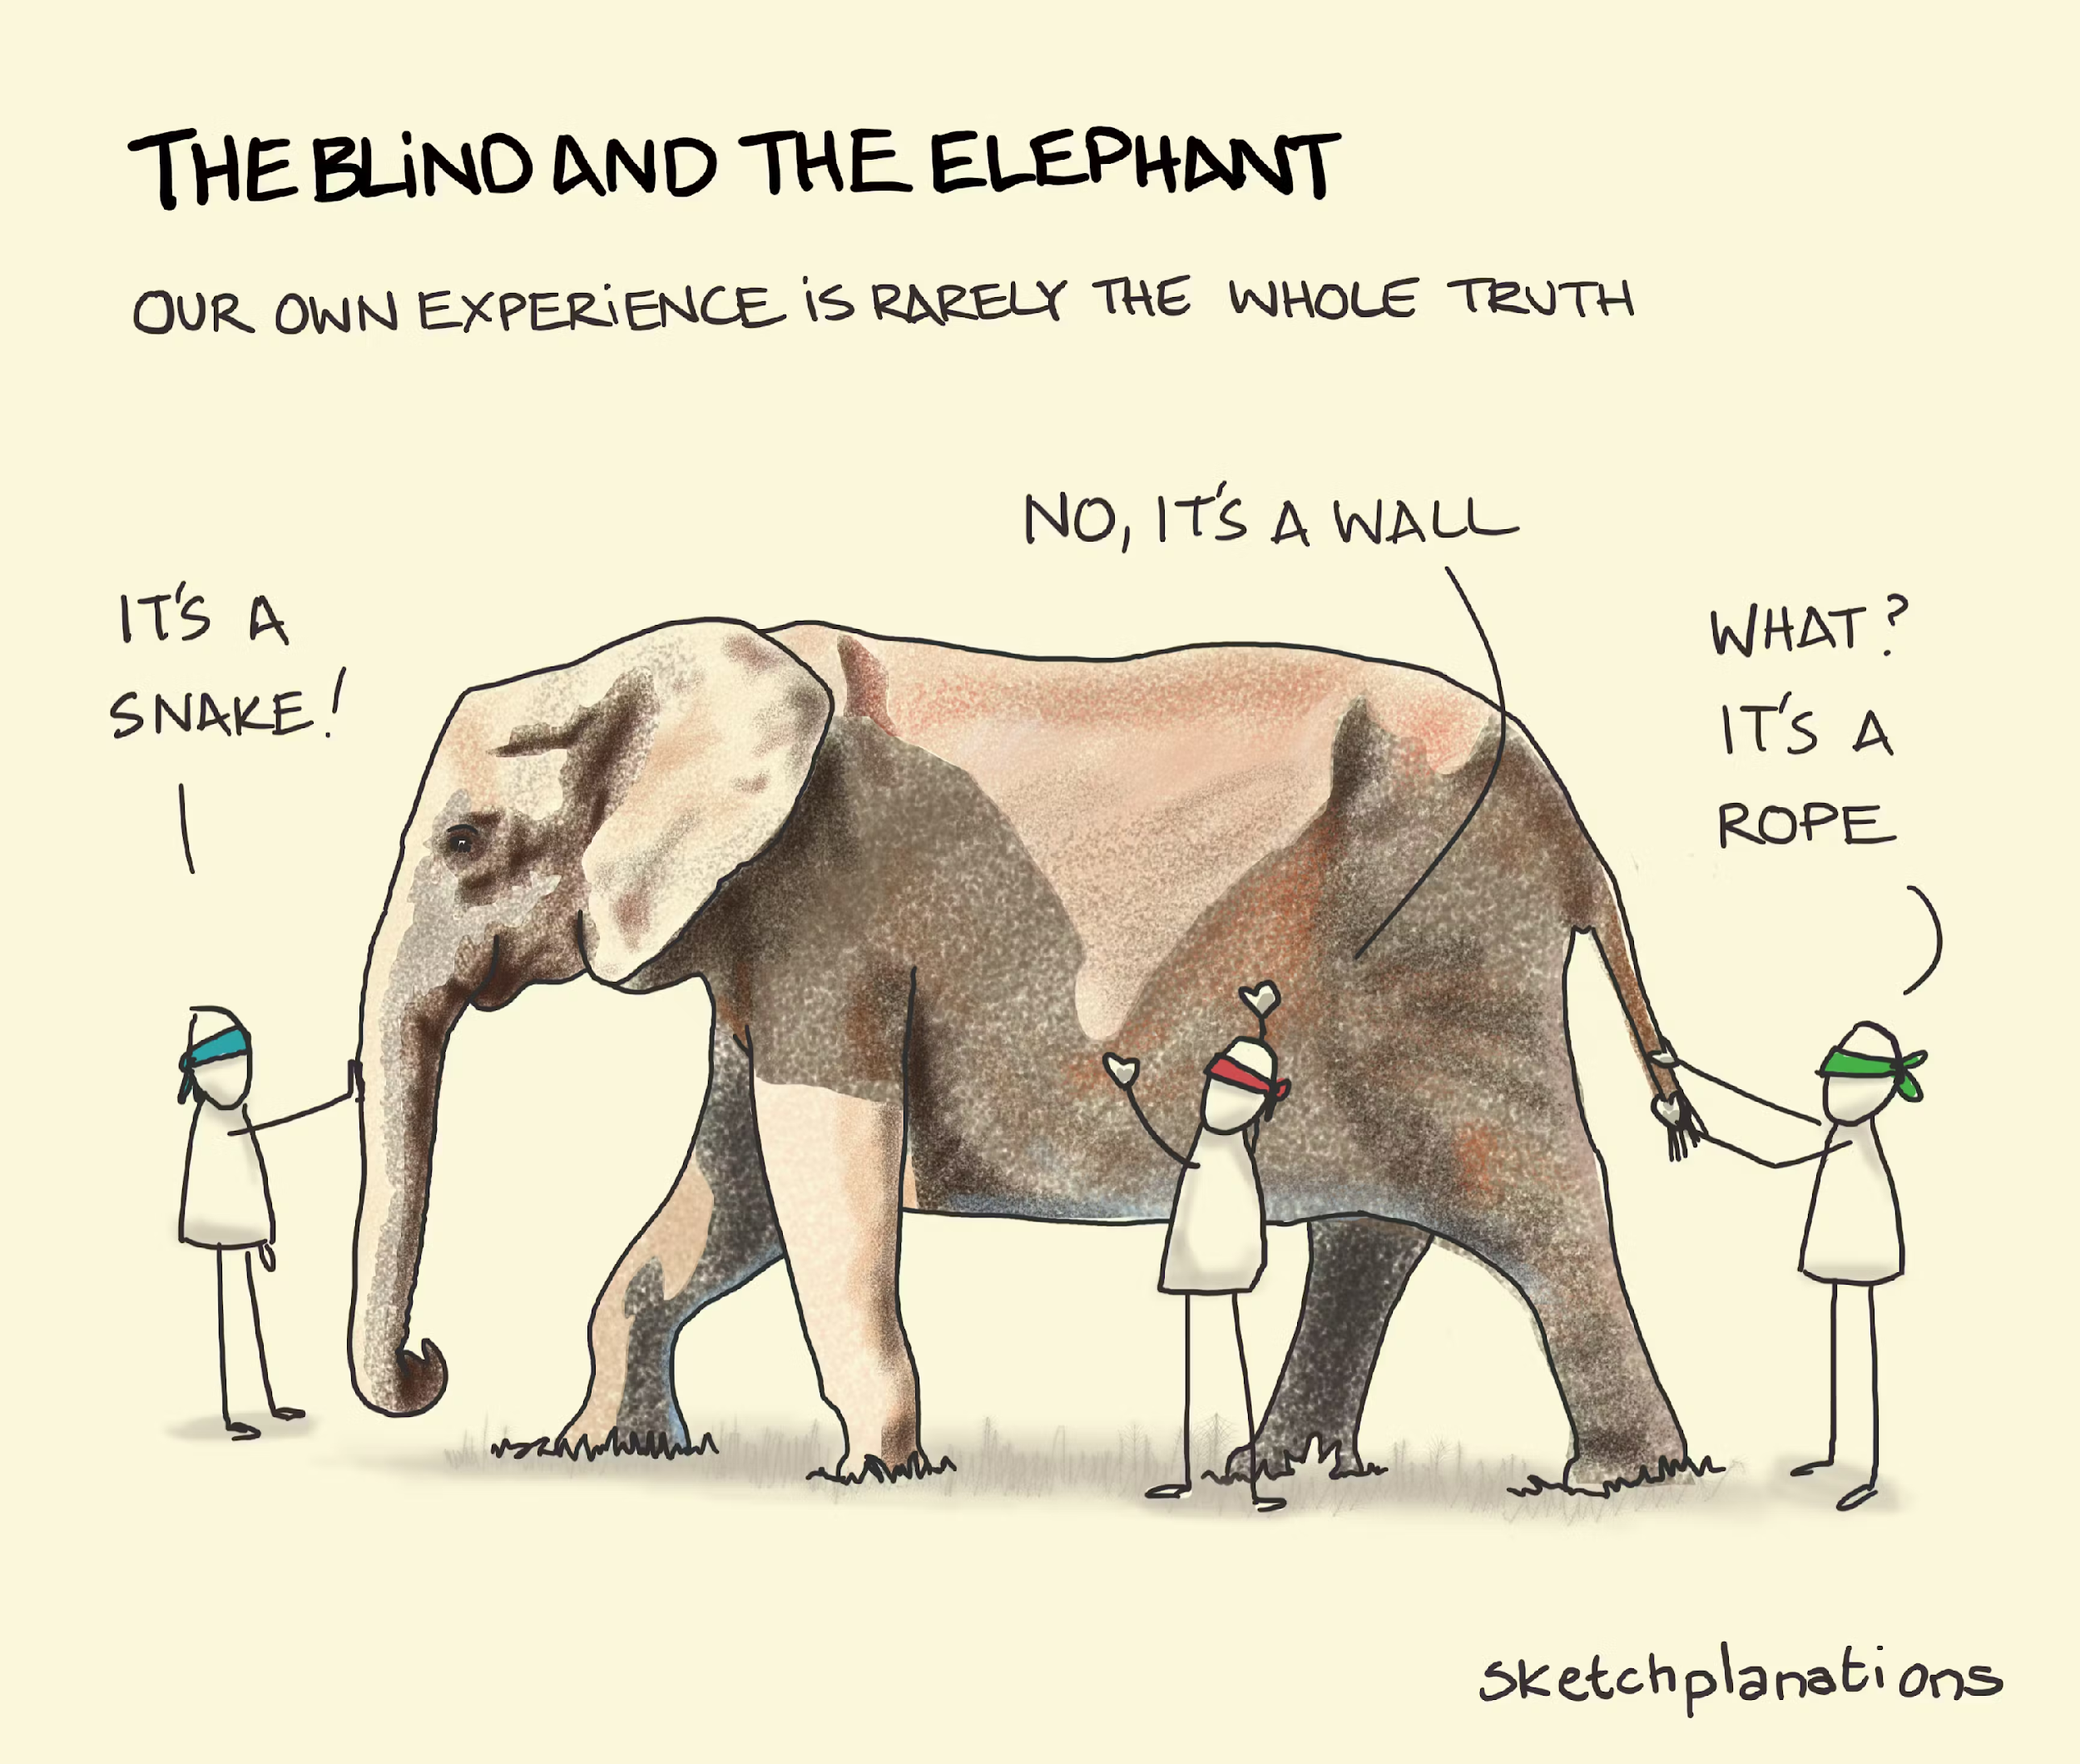
Varied perception
Varied perceptions are interesting in a philosophical discussion but are a barrier to smooth functioning in an organization.
The best solution is to step back and try to find an unbiased perspective.

Slide 13
You are in a meeting with people from your department. Some of them are your friends. One of your friends suggests a solution to a problem. Another colleague who is not your friend suggests a different solution. Your boss asks you to choose which of the solutions is better. Will you be able to give an unbiased perspective?

Slide 14
Differing backgrounds
People have different backgrounds due to different education, culture, language and financial status.
It is very important to know the background of the audience to communicate successfully.
The ability to understand where the audience is facing difficulty in understanding your message is important.

Slide 15
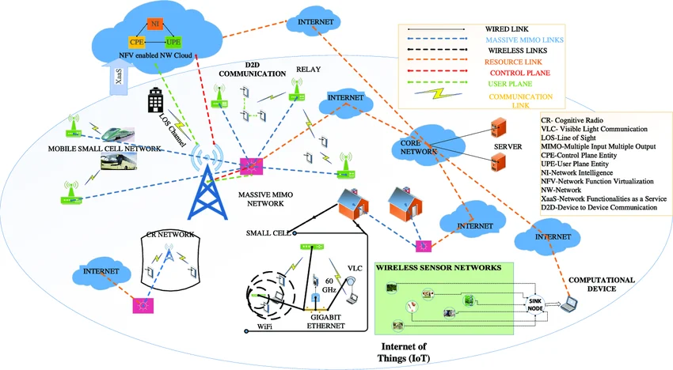
ARE YOU ABLE TO UNDERSTAND THE MESSAGE BEING CONVEYED IN THIS PICTURE?

Slide 16
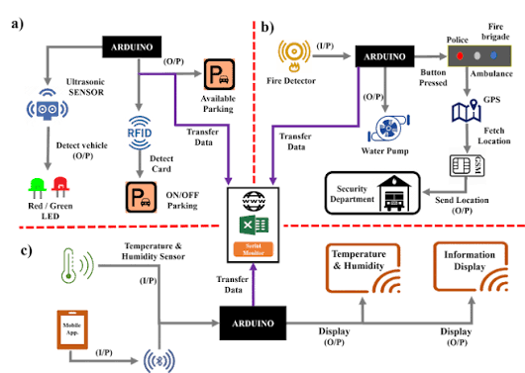

Slide 17
Important points to remember while speaking and writing
Use words that the audience will understand clearly. Keep this point in mind when using technical terms.
Always explain technical terms and their meaning.
At the same time, do not oversimplify. You might come across as unprofessional.

Slide 18
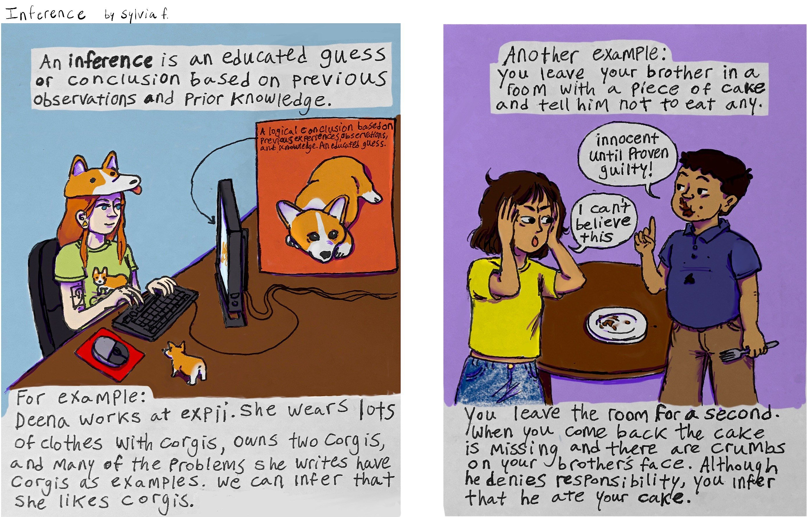
Wrong inference
“Never assume, always look for facts.”
You must draw inferences after collecting data or information.

Slide 19
Scenario 1
A colleague tells you that the manager you are supposed to report to is inefficient.
Will you believe you colleague? Would it impact your work? Will you try to form your own perception about him/her?

Slide 20
Scenario 2: What are the various inferences you can make from this situation?
While visiting a shopping mall, you walk past a coffee shop where you overhear the shop manager having a heated argument with a customer. You are in a hurry to get to the grocery store to pick up some food items, so you don’t care to stop at the coffee shop to figure out the reason for the heated exchange. The next day, you hit the mall again but this time you are in the mood for a relaxing cup of coffee. You approach the same coffee shop where you had witnessed the argument the previous day, and you notice that the same manager is on duty. Across the lobby, there is another coffee shop. Would you stop at the first coffee shop or choose to walk an extra 20 yards to go to the other coffee shop?

Slide 21
Blocked categories
Generally, we react positively to information that is consistent with our own opinions. (https://www.youtube.com/watch?v=Kho5KvPBDSw )
When we receive information that does not conform to our personal views, we tend to react negatively.
People, who have rigid thinking will face problems in communicating effectively.

Slide 22
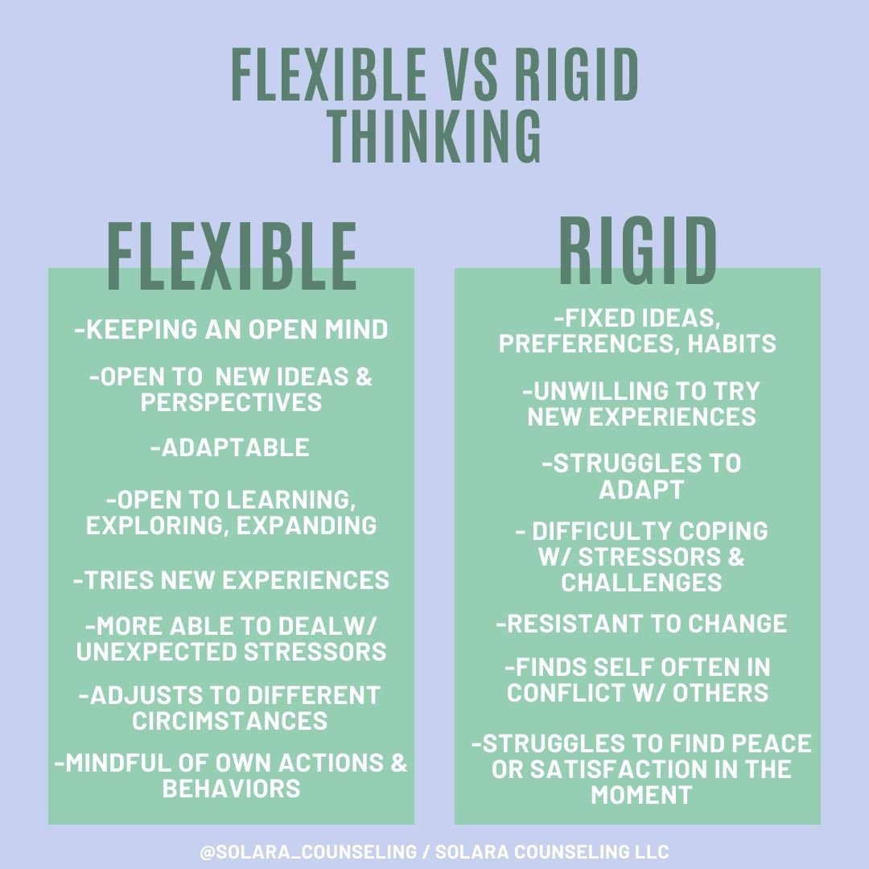
ARE YOU FLEXIBLE OR RIGID?

Slide 23
Categorical thinking or the ‘know-it-all’
Some people think they know everything.
They refuse to accept any new information.
Question
Doesn’t being a ‘know-it-all’ mean that you come across as confident?
How can it be a barrier?

Slide 24
How to avoid sounding like a ‘know-it-all?’
In a presentation, avoid using words like always, every time, everybody. Also avoid words such as never, nobody, nothing.
Use phrases such as ‘in most situations’, ‘most likely’.
While giving a personal opinion, say ‘According to me’, ‘it appears to me’.
While using facts from published research say ‘The article on…by….indicates that…’
When presenting your research say ‘ The evidence indicates.’

Slide 25
Interpersonal barriers
Interpersonal barriers arise due to inappropriate exchange of words between two or more people.
This can arise due to limitations in the communication skills of both the sender and the receiver.
This can also arise due to a negative environment in the workplace.

Slide 26
Common reasons for interpersonal barriers
Limited vocabulary
Incompatibility of verbal and non-verbal messages
Emotional outburst
Communication selectivity
Cultural variations*
Poor listening skills*
* There are no slides for these points
https://www.youtube.com/watch?v=gCfzeONu3Mo
(video explaining miscommunication. It covers some of the points mentioned on the left)

Slide 27
Limited vocabulary
Having a limited vocabulary is a barrier. However, having a wide vocabulary can be a possible barrier too.
If you have a wide vocabulary, you should be aware of the right usage of the words you have learned.

Slide 28
Understanding the ‘correct’ meaning of words
Effect means the result of a particular influence.
Affect means to have an influence on someone or something, or to cause a change in someone or something.
Example: ‘The new management wanted to effect drastic changes, but the unions felt these would adversely affect workers.’

Slide 29
Incompatibility of verbal and non verbal messages
Misinterpretation of non verbal cues can be a barrier to effective communication.
Non-verbal messages should be consistent with verbal messages.
Be aware of your body language as well as that of the audience.

Slide 30
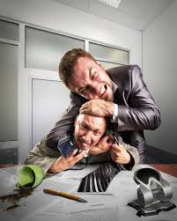
Emotional outburst
How can you control the situation if you or anyone else has an emotional outburst during a meeting?

Slide 31

Communication selectivity
When the receiver pays attention only to a part of the message, he is imposing a barrier.
He is probably interested in only one part of the message and ignores the other part.
Think about it
Isn’t selectivity essential in a world filled with information overload?
Why can it be a problem?

Slide 32

Organizational barriers
Too many transfer stations
Fear of superiors
Negative tendencies
Use of inappropriate media
Information overload
THINK ABOUT IT
How can you tackle each of these organizational barriers?

Slide 33
Too many transfer stations
This leads to distortion of information.
Example: X tells you to inform Y about a meeting at 10 am tomorrow. You are busy with work so you tell Z to communicate with Y. Z tells Y that the meeting is at 11 am.
What is a better solution?

Slide 34
Negative tendencies
Many organizations have work groups.
Some groups are also formed for recreational purposes.
Conflict of ideas between members and non-members can take place.
Example: You are part of the development team of a software company. You hear that the Business Development team is unhappy with your work. This might create a negative environment in the office.

Slide 35



Use of appropriate media
While deciding the medium of communication, keep the following factors in mind.
1. Time
2. Cost
3. Type of message
4. Intended audience

Slide 36

Information overload
Organizations handle a lot of data and they expect the human receiver to handle it effectively.
This leads to disinterest, fatigue,and boredom.
The quality of the information is more important than the quantity.

Slide 37
What is the full form of the following words?
PDF:
Portable Document Format
PNG:
Portable Network Graphics
SD CARD:
Secure digital card
URL:
Uniform Resource locator

Slide 38
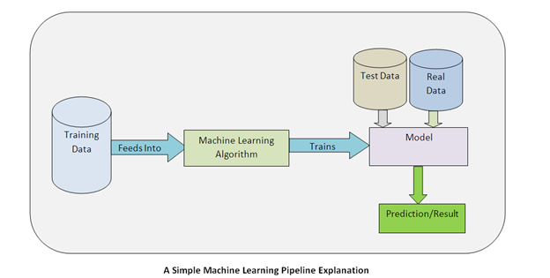
Explain in your own words

Slide 39
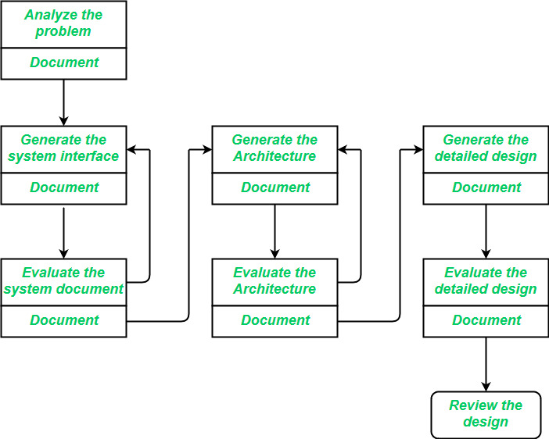
Explain the software design process.

Slide 40
Identify grammatical errors
Due to improvement in technology, LSI circuits is now very dense. One chip can has thousands of transistors. Chips like microprocessors contains many subsystem. They are no longer just circuits, they are systems. Circuit density are increase every year. How long can this continue? How small can transistor becomes? From physics, we know the transistor size can be reduce to less than one tenth of now. After that, they not work properly.
Many company are working on new methods. These help to make chips with more and more components. Transistors may become smaller than light wave.
This new technology give challenge to engineers and computer scientists. System design, hardware and software both will changes. So this will be important for computer science.Earlier, chip designing done by engineers in chip companies. Computer architect did not design chips. In college, EE and CS student study different topics.

Slide 41
Corrected paragraph
Due to improvements in technology, LSI circuits are now very dense. One chip can have thousands of transistors. Chips like microprocessors contain many subsystems. They are no longer just circuits, they are systems.
Circuit density increases every year. How long can this continue? How small can transistors become? From physics, we know the transistor size can be reduced to less than one tenth of what it is now. After that, they do not work properly.
Many companies are working on new methods. These help to make chips with more and more components. Transistors may become smaller than the wavelength of light.
This new technology gives a challenge to engineers and computer scientists. System design, hardware and software both will change. So this will be important for computer science.
Earlier, chip designing was done by engineers in chip companies. Computer architects did not design chips. In college, EE and CS students study different topics.

